Slide 1
Hello

Slide 2








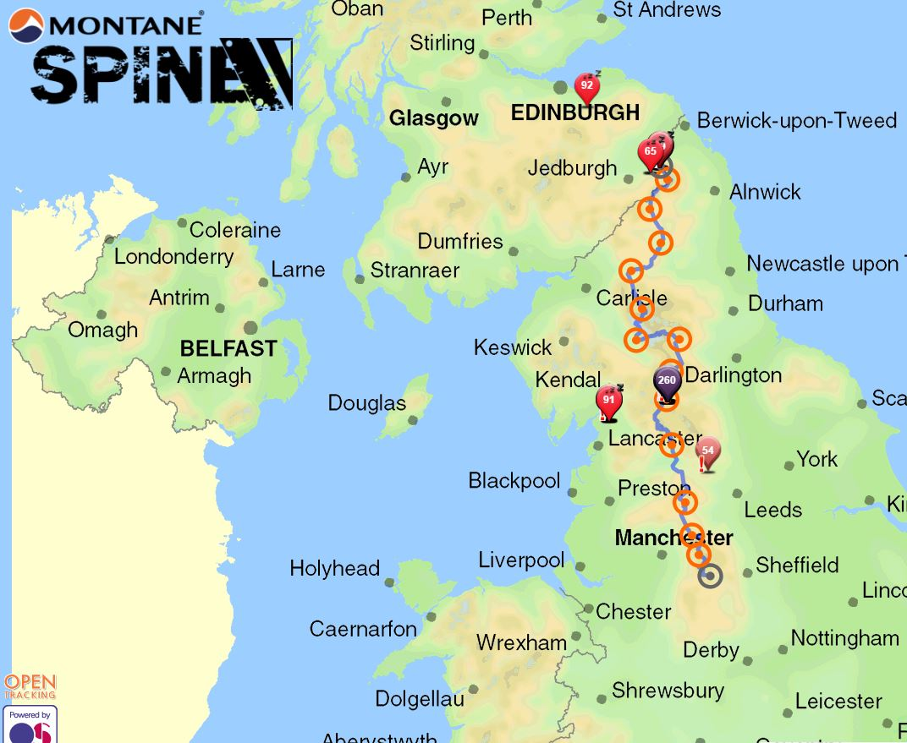





Who the Heck am I?

Slide 3

Who is Core29
The ‘Formal’ Description
We apply technology and processes to transform business performance, helping companies deliver growth and operational efficiency.
From business analysis and strategy, to planning, design, implementation and further enhancement through Business Intelligence, we tackle the complex application of digital technology that many business – even those at the cutting edge within their own sectors – find daunting and outside their comfort zone.
We are leaders in identifying and applying technology and processes to transform business performance. However, we don’t believe in a one-size-fits-all approach – instead we deliver by listening to the unique needs of our customers.
We pride ourselves on really getting to know the business we are working for, walking in their shoes, looking deep into the organisation, and working with them to implement the core processes and technology that help enables them becoming high-performing, innovative and sustainable businesses. This is how we make sure the solutions are fit for the future direction of the business.

Slide 4

Who is Core29
The Most Tenuous Jam Related Description Ever!!

Slide 5



The Tenuous Jam Link Continued…
Jam First
Delivering Diligence and Strategy Development, identifying pain points and sourcing technology or process solutions
Jam in the Middle
Translating business needs into Development requirements. Ensuring both parties are understood
Jam at the End
Supporting Delivery of technology solutions, embedding and further enhancement through Business Intelligence

Slide 6



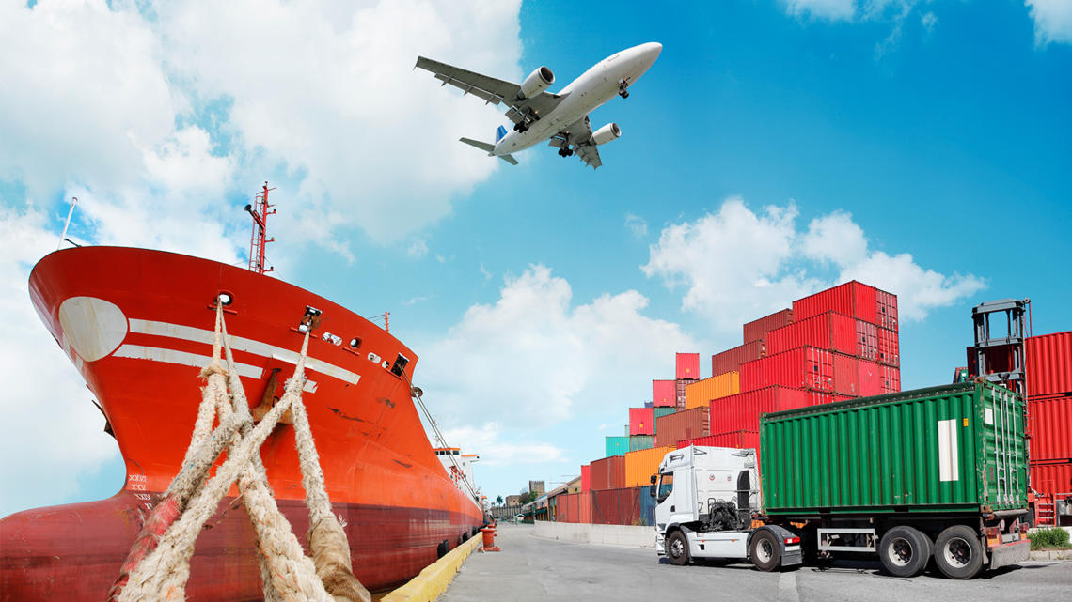
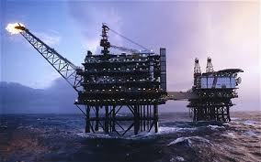
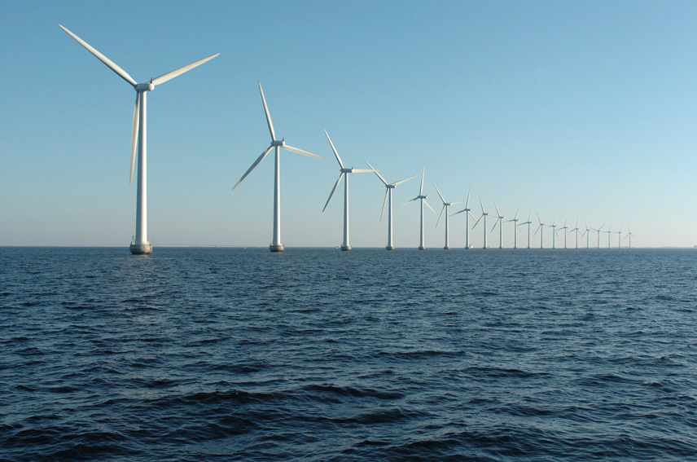

Where do we work
Hint: Where ever you find Jam really…..
Caveat: We don’t actually work with any Jam companies….Yet!

Slide 7











What matters to us.
Some words from the Core29 team
Our Team
Culture, Values and Identity
Families, Friends and Activities – That work life balance
Being Straight Forward
Straight up Fun ☺
Our Clients
Power of Technology and the way it Transforms business
Driving change to embrace the Value of Data.
Hearing not just Listening
Industry Diversification & Internationalisation
Community
Supporting Local Businesses and Local Ideas
Discovering, Developing & Supporting Talent
Collaboration & Partnerships
The Environment & Sustainability
JAM – Obviously!

Slide 8

Thanks for Listening

Slide 9
Core29 Challenge – Sustainability Themed
We need to reduce Emissions in our World
Offshore Logistics seeks to achieve Net Zero Goals
Reducing Vessel Emissions needs a Data led solution, and brings operational efficiency to existing assets & operations
Reducing the emissions of all logistics ultimately requires technologies and innovation - electrification

Slide 10
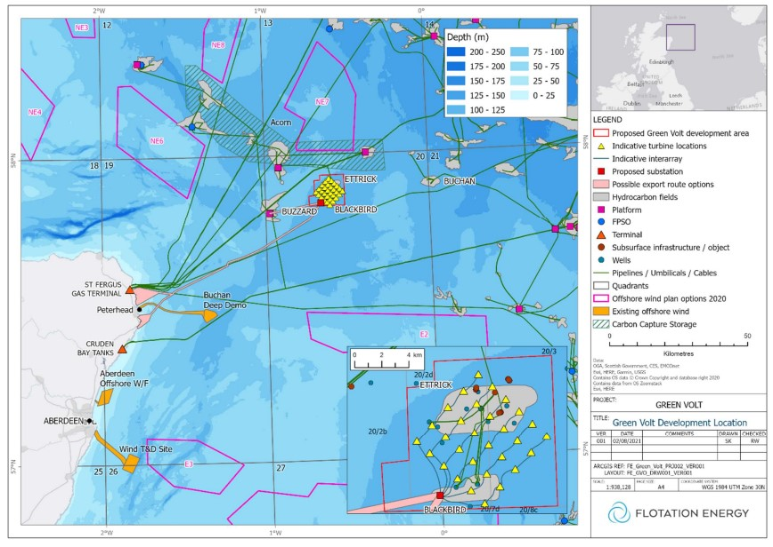
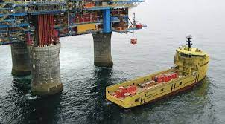
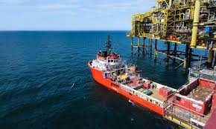
Vessel Emissions Calculator – The Scenario
The scenario
Vessel depart ports such as Aberdeen, Peterhead or Montrose.
They take cargo (liquids & containers) to multiple locations in a single journey.
Each location can be a unique client
Each client needs data on the emissions these operations generates – can we calculate this?
Wind and O&G Assets off N.E. Scotland
PSV (Platform Supply Vessels)

Slide 11
Vessel Emissions Calculator – The Variables
Vessel type – PSV (Platform Supply Vessel), the logistics asset for offshore operations
Assume Diesel for fuel consumption, energy efficiency and emissions
Journey distance
From any port to multiple offshore locations; I don’t think google maps does marine journey’s
Number of locations offshore visited in each journey
Number of clients served e.g. 6 locations can be 3 clients
Cargo volume / load
This will correlate to vessel emissions e.g. fully loaded takes longer
Multiple locations takes longer to service
PSV journeys
Delivering cargo & Collecting cargo to return to port or to move between offshore locations
Unlike an Amazon delivery van which leaves depot full and returns empty; PSV cargo load will vary through the journey, and can go from full to empty to full to half full on its return to port
Weather conditions
Accessing met ocean data and forecasts; impacts vessel speed and therefore emissions

Slide 12
Vessel Emissions Calculator – The Goal
Can we create a route planner
The most fuel efficient route, lowers fuel consumption and lowers emissions
Can we create an emissions calculating tool
Some of the variables may not all be possible to be incorporated; some assumptions may be applied instead
Can we split out the emissions from a journey to individual clients
Simple version – each journey has a single client
More complex – multiple clients, varying vessel loads
This is a transferrable challenge, as marine transport also applies to global shipping, with container and bulk cargo movements; air logistics and road logistics.
We are reliant on the efficient movement of goods, so lower emissions benefits everyone

